Slide 1


Department Of Electrical And Electronics Engineering
Final Year (2020-2024) Batch –VIII Semester
18EEP402L - Project Work Phase II
FINAL VIVA VOCE
SMART DRIVE INNOVATION: Li-Fi-ENABLED SMART TRANSACTIONS, ADAPTIVE LIGHTING, AND AUTOMATED BRAKING FOR ENHANCED SAFETY AND
DRIVE-THRU EXPERIENCE
PRESENTED BY:
GUIDED BY:
ABINAYA.P
ABIRAMI.S
INDHUMATHI.R
MADHURAMBIGA.S
(20BEE4001)
(20BEE4002)
(20BEE4023)
(20BEE4045)
Mr. S. DINESHKUMAR,
Assistant professor,
Department of EEE.

Slide 2
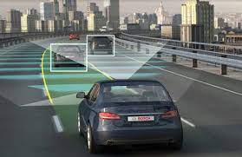
OVERVIEW OF THE PRESENTATION
INTRODUCTION
ABSTRACT
COMPARISON OF PHASE 1 AND PHASE 2
EXISTING SYSTEM
PROPOSED SYSTEM
BLOCK DIAGRAM & FLOWCHART
IMPLEMENTATION STRATEGY
LIST OF COMPONENTS
HARDWARE KIT IMAGE & OUTPUTS
OUTPUT DISCUSSION
CONCLUSION
FUTURE SCOPES
LIST OF PUBLICATIONS
CONTEST EXPOSURE
REFERENCES

Slide 3
INTRODUCTION
Today, vehicles are no longer mere modes of transportation; the concept of Li-Fi (Light Fidelity) has given birth to a revolutionary paradigm for enhanced safety and drive-thru convenience.
In Smart Payment, Li-Fi enables high-speed data exchange between the vehicle and payment systems, enhancing user convenience and reducing the need for physical cards or devices.
With the goal of preventing accidents and enhancing traffic flow, Li-Fi technology has been
used in brake applications and real-time risk notifications while approaching neighboring vehicles.
In Adaptive lighting systems, Li-Fi enhancing safety by dimming the light of the approaching vehicle, when that vehicle approaches with high light intensity.

Slide 4
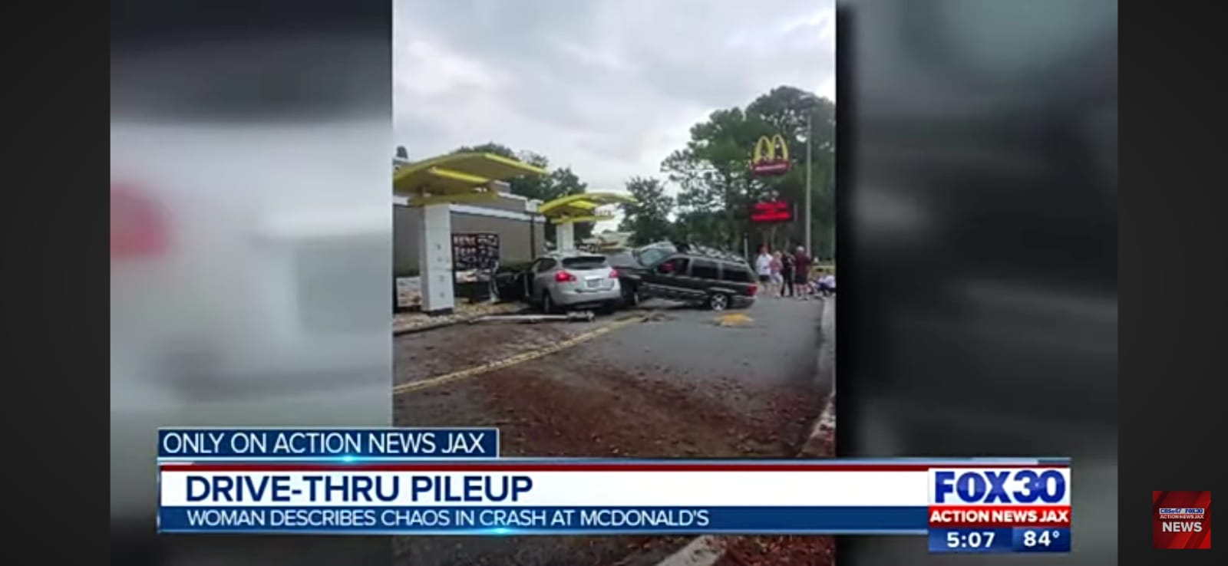
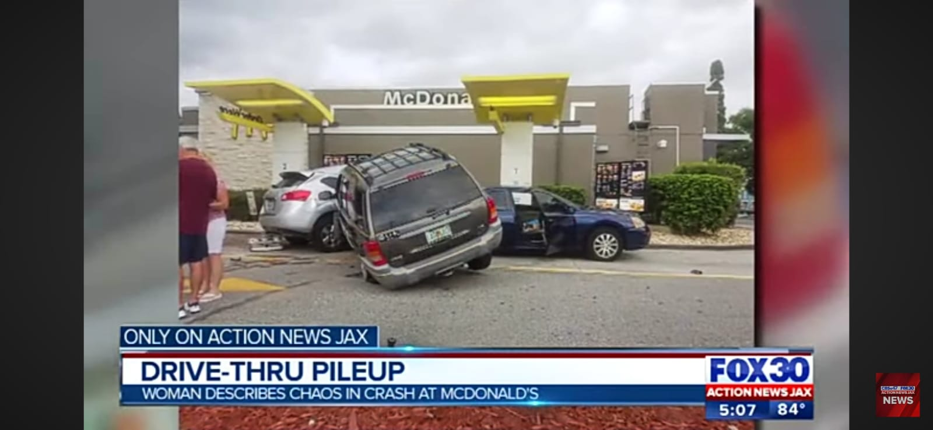
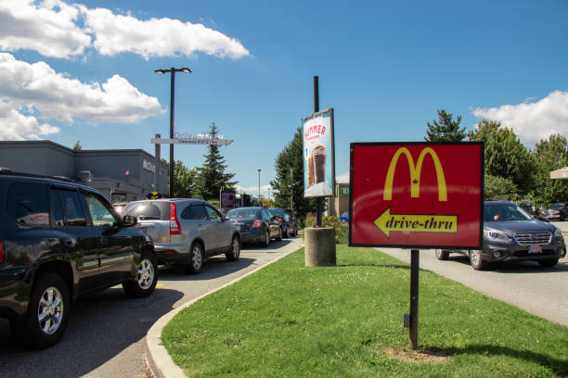
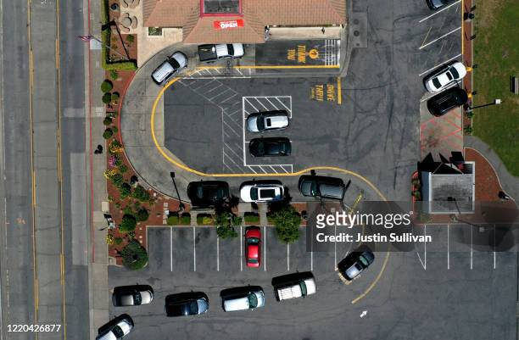
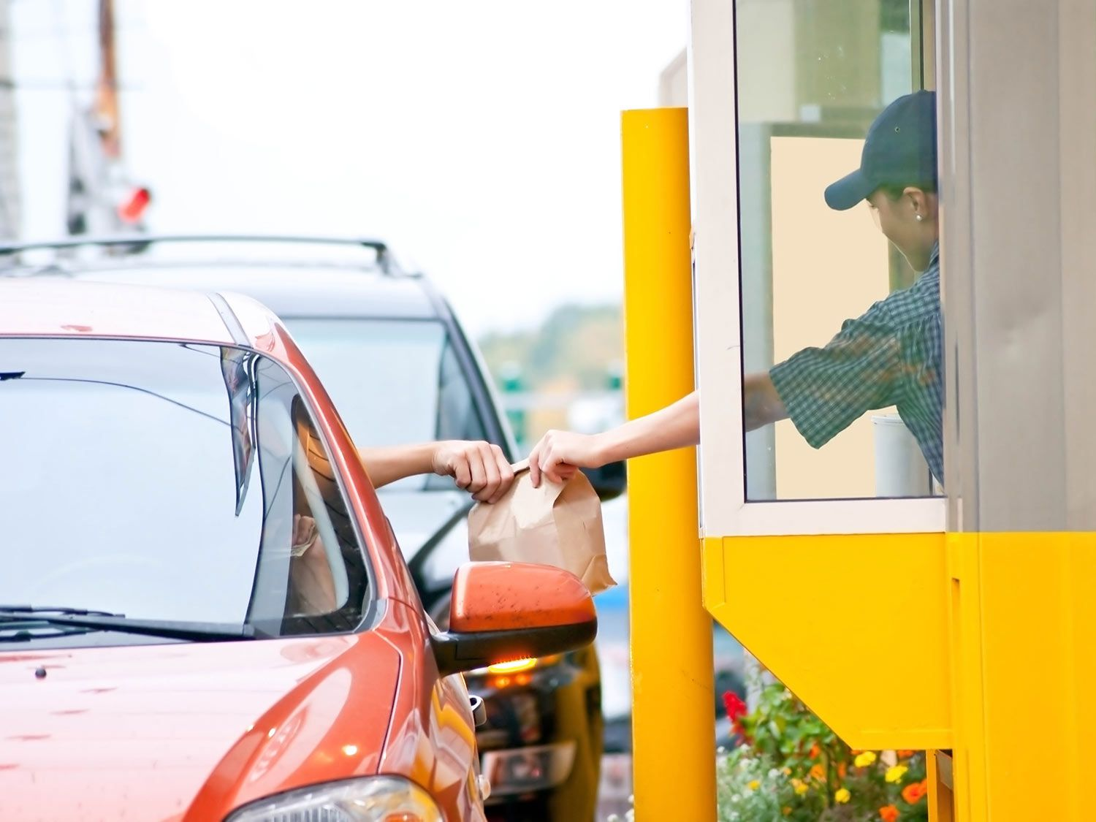

Slide 5
ABSTRACT
In recent years, there has been a lot of interest in the idea of using Li-Fi technology as the engine of intelligent systems. The goal of this idea is to improve safety and transform the drive-through encounter. To guarantee a comfortable and effective driving experience, the system is built with smart payment choices, adaptive lighting, and brake automation.
Additionally, this technology is employed to improve safety and prevent auto accidents. In order to communicate between the cars moving at a safer distance, an ultrasonic sensor is employed to measure distance. It notifies drivers of impending danger and activates autonomous braking when it approaches other cars. It's also utilized to reduce light intensity when a car approaches with a lot of light.
In addition, the system boasts an intuitive LCD display for simple monitoring and control, as well as intelligent drive-thru smart payment options.

Slide 6
COMPARISON OF PHASE 1 AND PHASE 2
PHASE 1 | PHASE 2
Li-Fi involved in payment transaction of drive-thru to make it ease. | Here, Li-Fi is involved for the brake automation, light adaptation and payment within the drive-thru lane.
The implementation of the project through simulation of proteus design. | The implementation of project is through hardware kit.
In proteus simulation, have used distance relay for measuring distance between the vehicle. | In hardware, have used ultrasonic sensor for measuring distance between the vehicle.
In simulation ,Node MCU is have not separately mentioned transmitter and receiver. | In hardware, Node MCU is being used and have separately displaying transmitter and receiver.

Slide 7
EXISTING SYSTEM
In existing payment systems for vehicles, RFID technology can be used to streamline toll collection and parking payments. RFID tags are affixed to the vehicle, enabling automatic detection and deduction of fees as the vehicle passes through toll booths or enters parking facilities.
RFID technology has limitations in terms of range, real-time data handling, susceptibility to interference, and security, making it less suitable for certain applications where Li-Fi offers advantages.
In existing, Vehicle-to-vehicle Communication (V2V) is done using the concept of Visible Light Communication (VLC). By modulating the vehicle's taillights, it is possible to transmit event-based messages with the current status of the car. But VLC has only unidirectional communication and both RFID and VLC have less data transfer speed compared to LI-FI.

Slide 8
EXISTING SYSTEM
ASPECTS | EXISTING SYSTEM | PROPOSED SYSTEM
Smart Payment | Reliance on traditional payment methods(cash, card) | Integration of Li-Fi for se- cure, high-speed transactions.
Adaptive Lighting | Manual control of vehicle lighting. | Li-Fi enabled adaptive light- ing for enhanced safety.
Brake Automation | Limited automation fea- tures. | Li-Fi driven brake automation for imposed responsiveness.

Slide 9
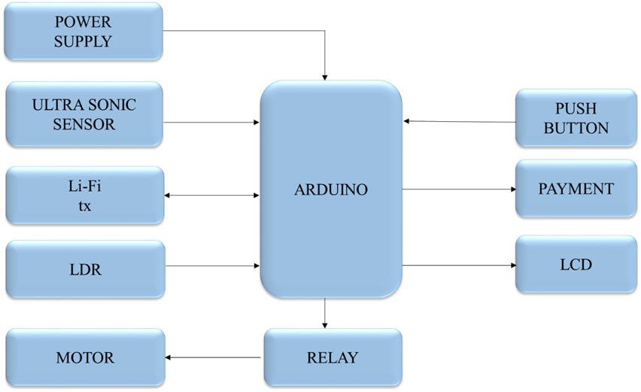
PROPOSED SYSTEM BLOCK DIAGRAM

Slide 10
PROPOSED SYSTEM block DIAGRAM
POWER
SUPPLY
LCD
Node MCU
RELAY
LAMP
Li-Fi
rx
10

Slide 11
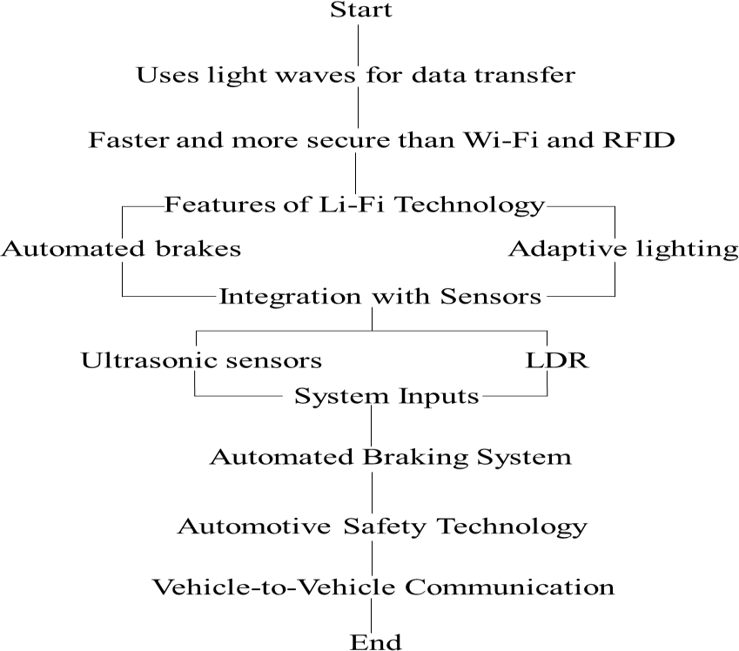
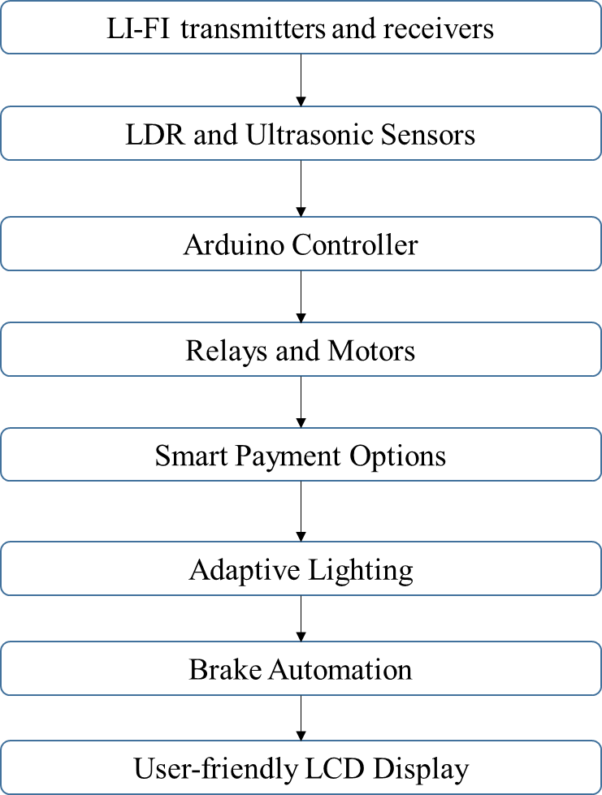
PROPOSED SYSTEM flowchart

Slide 12
Implementation strategy
This technology has the potential to revolutionize the driving experience by providing smart payment options, adaptive lighting, and brake automation. In Smart Payment, it consists of two main parts: the vehicle unit and the drive-through unit. The vehicle unit will be installed in the customer’s vehicle , while the drive-through unit will be installed in the drive-through lane of the payment area.
Vehicle Unit: The vehicle unit will contain all the necessary components, including the Li-Fi receiver, LDR and ultrasonic sensors, Arduino controller, and LCD display. The Li-Fi receiver will be connected to the Arduino controller, which will receive data from the sensors and process it. The processed data will be displayed on the LCD display for real-time monitoring.
Drive-thru Unit: The drive-thru unit will contain the Li-Fi transmitter and the relays for enabling smart payment in the drive thru lane. The Li-Fi transmitter will be connected to the Arduino controller, which will transmit data to the vehicle unit and process the payment system accordingly.

Slide 13
Implementation strategy contd,..
The LDR sensors are used to detect the intensity of light, while the ultrasonic sensors measure the distance between the vehicle and the surrounding objects. These sensors provide essential data inputs for the system, enabling it to adapt and respond to changing driving conditions
An automatic braking system is an important part of safety technology for automobiles. It is an advanced system, specifically designed to either prevent possible collision, or reduce speed of the moving vehicle, prior to a collision with another vehicle, pedestrian or an obstacle of some sort.
Overall, the suggested technique offers a dependable and effective way to follow the leading vehicle while vehicle-to-vehicle communications are in progress.

Slide 14
List of COMPONENTS
COMPONENTS | SPECIFICATIONS | COST
Arduino | UNO | 750
Node MCU | (Esp8266) 3.3v | 450
Led Sheet | - | 50
LCD | 16*2 | 350
Relay | 12v 7ah | 450
Diode | In 4007 | 60
Capacitor | 25v 1000uf | 60
Ultrasonic Sensor | 3.3v – 5v | 2300
DC Motor | 12v | 100
Voltage Regulator IC | 7805 | 50
PIC Microcontroller | PIC16F877 | 130
LDR | 5mm | 10

Slide 15
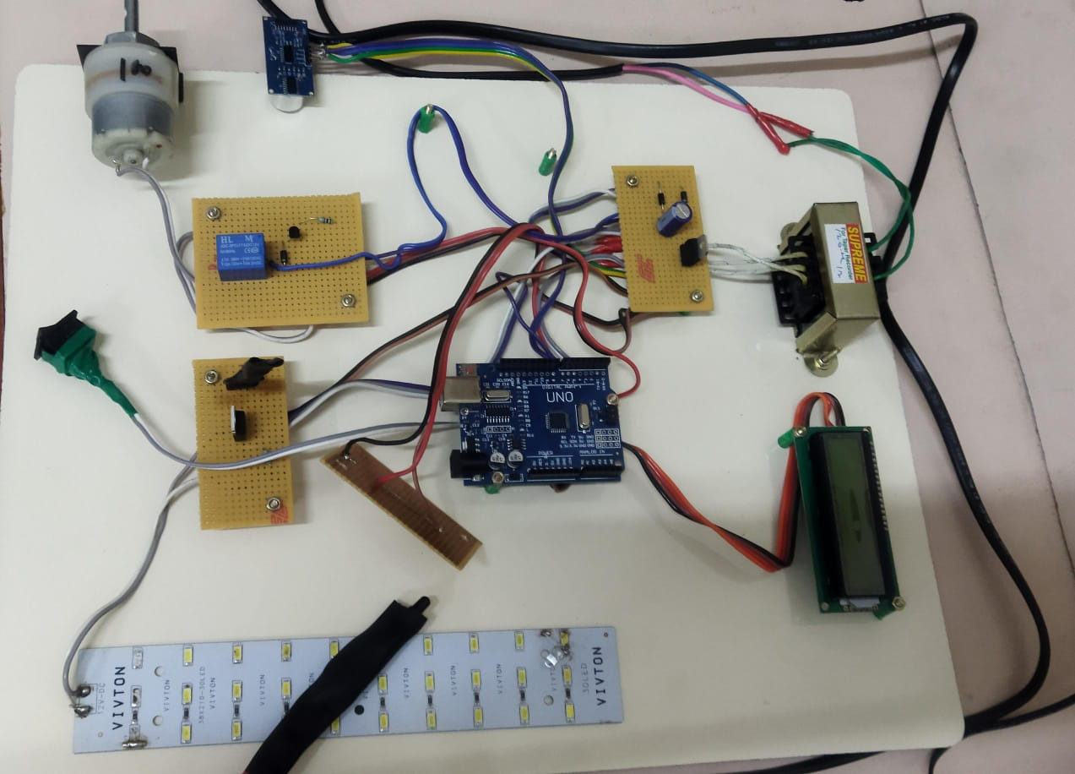
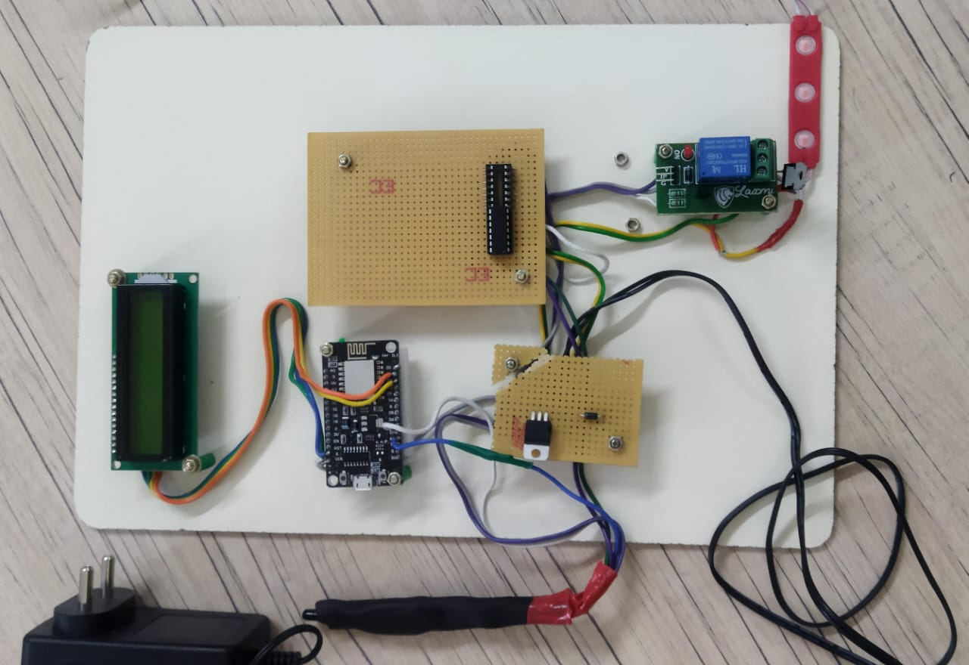
HARDWARE IMPLEMENTATION
v
Braking Automation & Smart Payment Adaptive Lighting

Slide 16
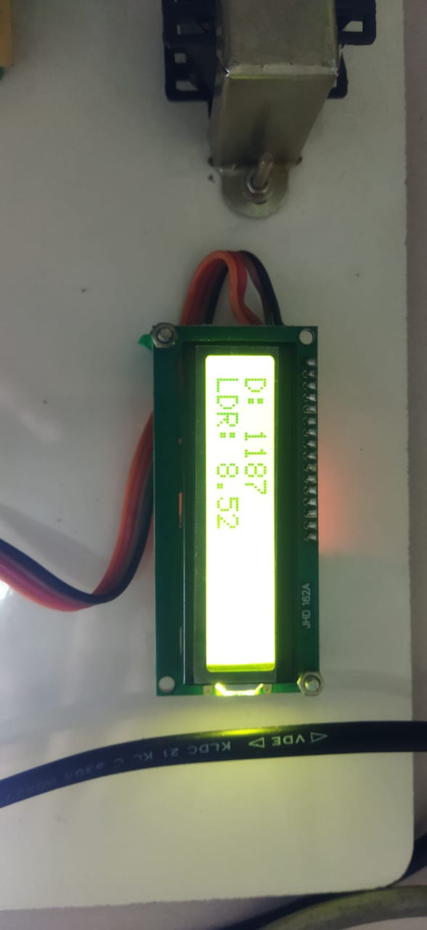
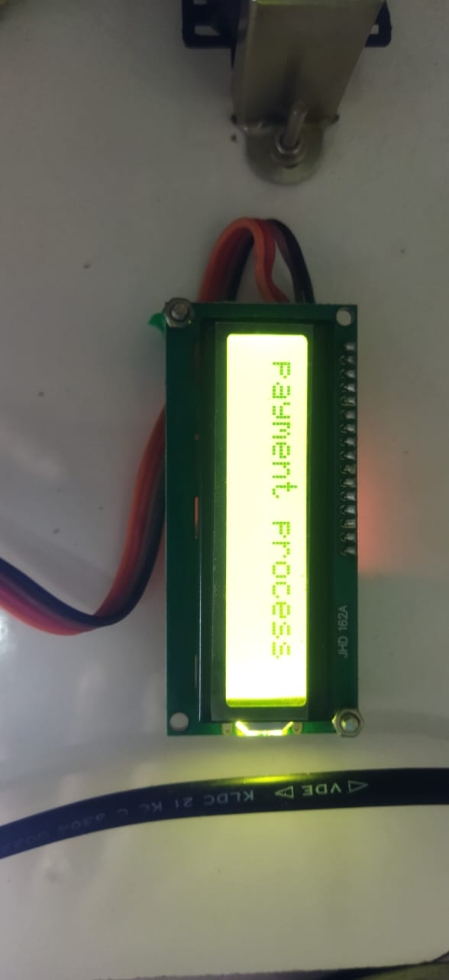
HARDWARE OUTPUTS
LCD shows the LDR intensity value
and Distance between the vehicles
LCD displaying the payment transaction
process

Slide 17
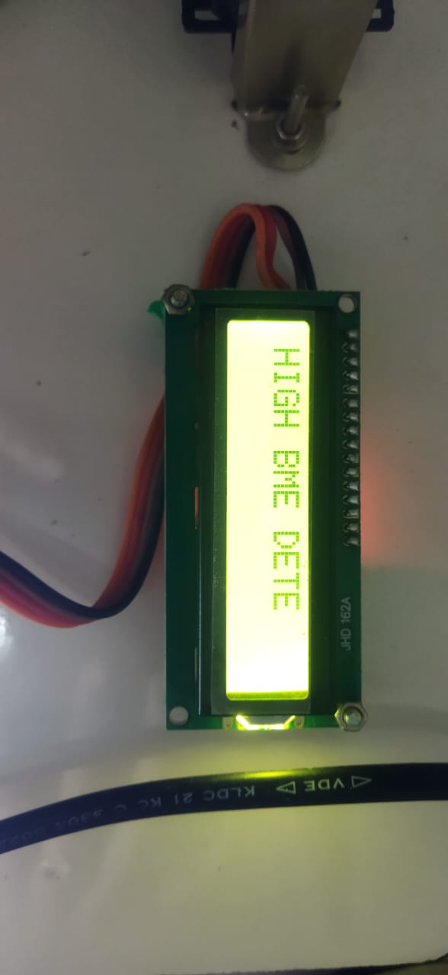
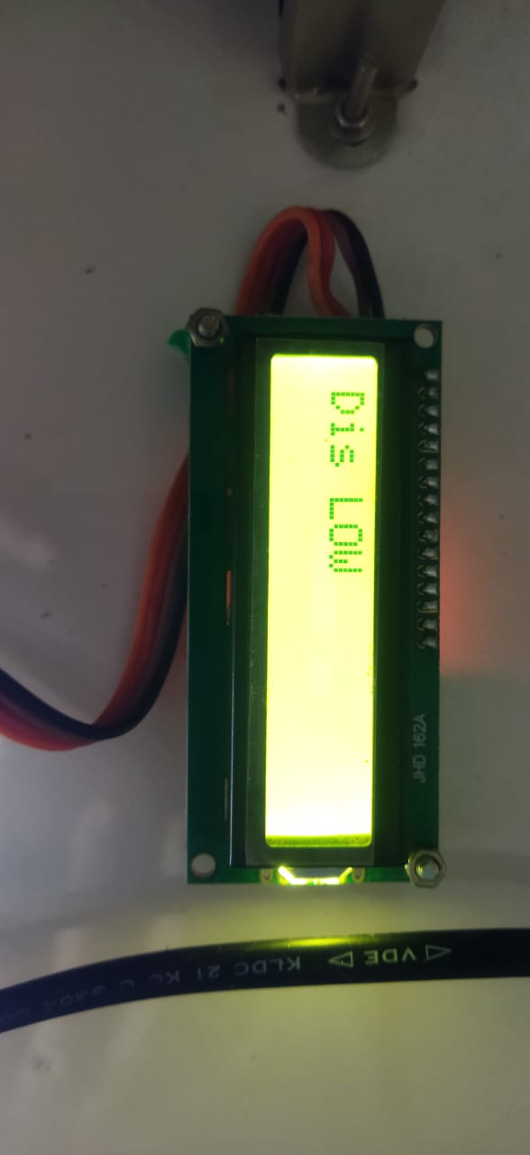
HARDWARE OUTPUTS
LCD displaying High beam Detected
LCD Displaying Low Distance Break is ON

Slide 18
OUTPUT DISCUSSION
When the power supply is switched ON, LDR and Ultrasonic sensor will sense the light intensity and distance of the vehicle respectively. The measured value will be shown in the LCD for driver’s indication.
When the vehicle is approaching with high intensity, the light will be dimmed by use of Li-Fi transmitter and receiver, and it displays “High Beam detected”. If the vehicle is closer to another vehicle, the ultrasonic sensor will measure and helps for automatic breaking.
In Drive-thru, the payment switch is used for payment process and LCD displays “payment process”. All these process are controlled by Arduino and by use of Li-Fi transmitter and receiver the two vehicles will exchange their information.

Slide 19
CONCLUSION
Intelligent systems powered by Li-Fi have great potential to transform smart payments and improve safety in self-driving cars, especially with features like adaptive lighting and brake automation. These developments, along with Li-Fi technology, might make the automotive sector safer and more productive in the future.
The payment procedure is guaranteed to be simple and effortless owing to this framework's integration of smart payment systems. In addition to improving safety, these advancements open the door to a more intelligent and connected transportation environment, which will ultimately lead to better road safety and overall driving experiences.

Slide 20
FUTURE SCOPES
The integration of Li-Fi-enabled smart transactions, adaptive lighting, and automated braking systems promises to revolutionize the driving experience by offering secure and efficient in-vehicle transactions, personalized ambiance, and enhanced safety features.
The innovation not only optimize convenience and comfort but also contribute to improved road safety in drive-thru and increases efficiency through advanced collision avoidance capabilities and data-driven insights, paving the way for a smarter and more seamless driving future.

Slide 21
List of publications
1.S.Dinesh Kumar, P.Abinaya, S.Abirami, R.Indhumathi and S.Madhurambiga “SMART DRIVE INNOVATION LI – FI ENABLED SMART TRANSACTIONS, ADAPTIVE LIGHTING AND AUTOMATED BRAKING FOR ENHANCED SAFETY AND DRIVE THRU EXPERIENCE” 5th International Conference on Power and Embedded Drive Control (ICPEDC-2024), organised by SSN College of Engineering during 17th and 18th January 2024. (ACCEPTED FOR SPRINGER).
2.S.Dinesh Kumar, P.Abinaya, S.Abirami, R.Indhumathi and S.Madhurambiga “SMART DRIVE INNOVATION LI – FI ENABLED SMART TRANSACTIONS, ADAPTIVE LIGHTING AND AUTOMATED BRAKING FOR ENHANCED SAFETY AND DRIVE THRU EXPERIENCE” 2nd IEEE International Conference on Device Intelligence, Computing and Communication Technologies (DICCT – 2024) organised by Graphic Era(Deemed to be University) during 14th and 15th March 2024. (ACCEPTED FOR IEEE -EXPLORER).

Slide 22
contest exposure
Contest Name : TECHguim 7th edition 2024
Challenge statement : “Glare caused a headlights high beam having a
handled dazzling effect for oncoming traffic”
Feature of the project that
contributes the challenge : Adaptive lighting
Participation Status : At Stage - POC demonstration

Slide 23
REFERENCEs
Harald Haas, Liang Yin, Cheng Chen , Stefan Videv, Damian Parol, Enrique Poves, Hamada Alshaer, Mohamed SufyanIslim ,” Introduction to indoor networking concepts and challenges in LiFi”, IEEE/OSA Journal of Optical Communications and Networking ( Volume: 12 , Issue: 2 , February 2020 ).
W.-L. Jin, “SPIVC: A Smartphone-based inter-vehicle communication system,” Proceedings of Transportation Research Board Annual Meeting, 2012.
Jaina Patel , Pranati Trivedi , Drashti Patel,”A Performance Analysis of “Light Fidelity” and “Internet of Things” & It's Application”, 2017 International Conference on Transforming Engineering Education (ICTEE).
Niharika Mishra, Monika Rai, RiyaMandal, HarjeetKaur.”Navigation System using Light Fidelity” 2018 2nd International Conference on Trends in Electronics and Informatics (ICOEI).
Harald Haas, Liang Yin, Yunlu Wang, Cheng Chen,” What Is LiFi?”, Journal of Lightwave Technology (Volume:34, Issue:6, March15,2016 ).
MOSAIF Afaf, RAKRAK Said ”An Indoor Wireless Visual Sensor Network basing on Light-Fidelity Communication”,2017 International Conference on Wireless Networks and Mobile Communications (WINCOM).
Justice OwusuAgyemang, Jerry John Kponyo, Mouzna Joseph, “Light Fidelity(LiFi) as An Alternative Data Transmission Medium in VANET” , 2017 European Modelling Symposium (EMS).
Niharika Mishra, Monika Rai, RiyaMandal, HarjeetKaur.”Navigation System using Light Fidelity” 2018 2nd International Conference on Trends in Electronics and Informatics (ICOEI).

Slide 24
REFERENCEs
Y. Yang and X. Wang, "Fast RFID Tag Sorting at the Edge for Internet of Things," in IEEE Access, vol. 9, pp. 90268-90282, 2021, doi: 10.1109/ACCESS.2021.3090438.
S. Guohui et al., "Research on Payment, Clearing and Settlement System Based on Electric Vehicle Intelligent Networking Platform," 2021 International Conference on Power System Technology (POWERCON), Haikou, China, 2021, pp. 678-683, doi: 10.1109/POWERCON53785.2021.9697723.
D. Pašalić, B. Cvijić, D. Bundalo, Z. Bundalo and R. Stojanović, "Vehicle toll payment system based on Internet of Things concept," 2016 5th Mediterranean Conference on Embedded Computing (MECO), Bar, Montenegro, 2016, pp. 485-488, doi: 10.1109/MECO.2016.7525699.
N. Lu, N. Cheng, N. Zhang, X. Shen and J. W. Mark, "Connected Vehicles: Solutions and Challenges," in IEEE Internet of Things Journal, vol. 1, no. 4, pp. 289-299, Aug. 2014, doi: 10.1109/JIOT.2014.2327587.
G. Raj Suriyan, K. Rahul, S. Rajesh, C. Dhanalakshmi and G. Udhayakumar, "Prevention of Road Accidents by Interconnecting Vehicles using LiFi and LoRaWAN Technologies," 2023 International Conference on Sustainable Computing and Smart Systems (ICSCSS), Coimbatore, India, 2023, pp. 1383-1387, doi: 10.1109/ICSCSS57650.2023.10169475.
M. Leba, S. Riurean and A. Lonica, "LiFi — The path to a new way of communication," 2017 12th Iberian Conference on Information Systems and Technologies (CISTI), Lisbon, Portugal, 2017, pp. 1-6, doi: 10.23919/CISTI.2017.7975997.
D. R. Bolla, Shivashankar, R. Praneetha and B. S. Rashmi, "LI-FI TECHNOLOGY BASED AUDIO AND TEXT TRANSMISSION," 2019 4th International Conference on Recent Trends on Electronics, Information, Communication & Technology (RTEICT), Bangalore, India, 2019, pp. 1532-1537, doi: 10.1109/RTEICT46194.2019.9016856.
S. Dinesh and B. Chourasia, "Light Fidelity (Li-Fi) Technology: Will It Be An Eco-Friendly For Monitoring The Covid-19 Patients In Hospital," 2021 International Conference on Advance Computing and Innovative Technologies in Engineering (ICACITE), Greater Noida, India, 2021, pp. 234-238, doi: 10.1109/ICACITE51222.2021.9404680.

Slide 25
THANK YOU….!

